Slide 1



PROJECT
WEBSITE AUDIT & DIGITAL MARKETING IMPLEMENTATION
BY KRISH RANA

Slide 2

Introduction
WEBSITE AUDIT & DIGITAL MARKETING IMPLEMENTATION – UNIFIED MENTOR
Unified Mentor is an online e-learning platform offering skill-based courses and mentorship
The website plays a critical role in lead generation, brand credibility, and user engagement
A detailed website audit and digital marketing strategy was conducted to improve performance and visibility

Slide 3
Our Objectives
To analyse and identify areas for improvement (content, blog, on page, off page, technical SEO) on the chosen e-learning website.
To redesign and optimise the website for improved user experience and conversion rates.
To create a comprehensive digital marketing strategy.

Slide 4
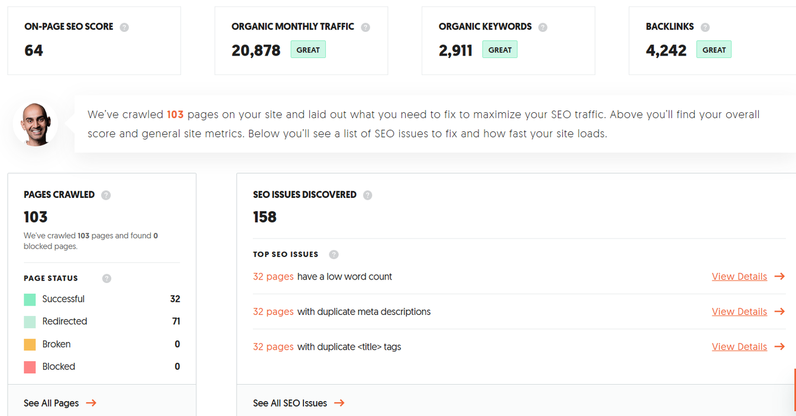
Site Audit

Slide 5
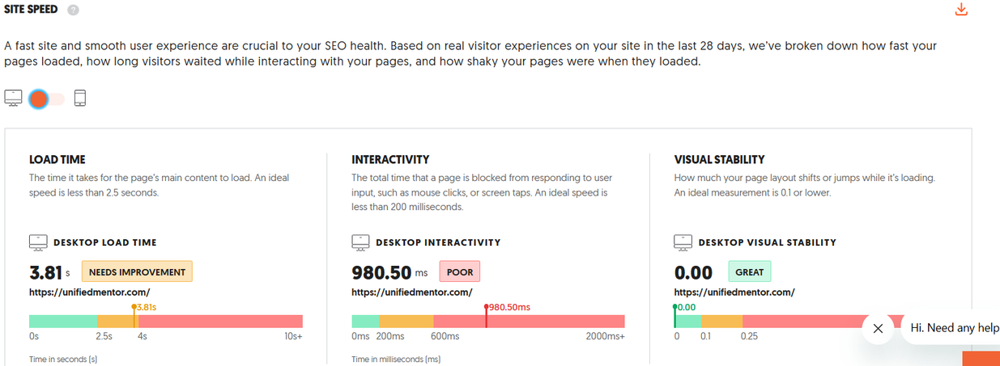
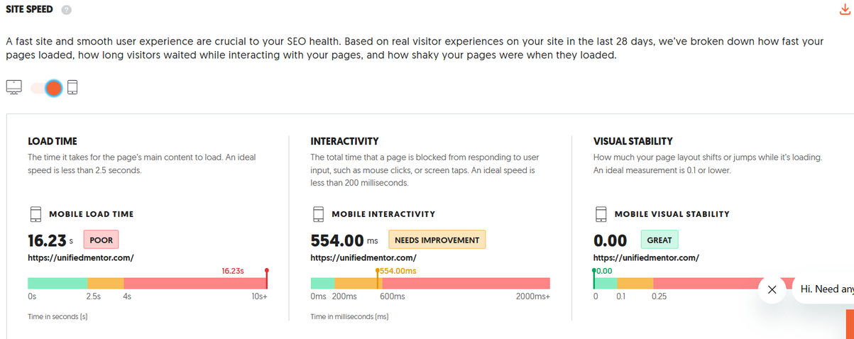

Slide 6
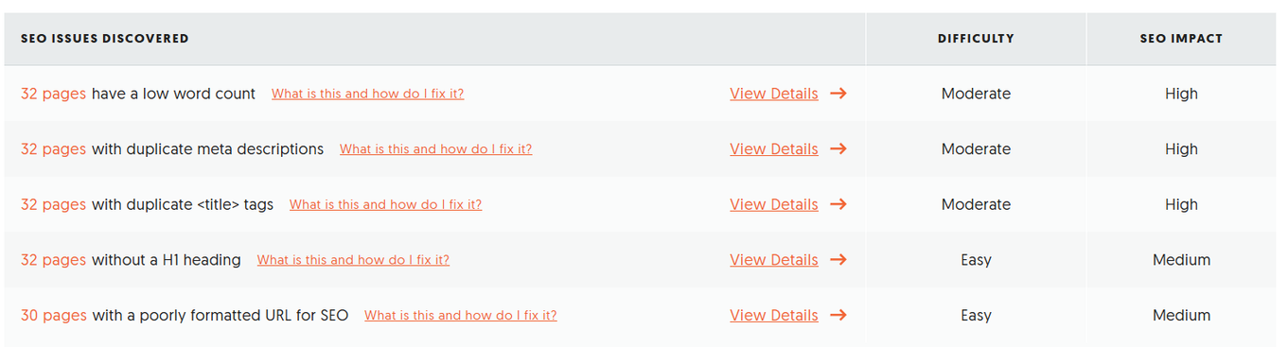
Issues (UberSuggest)
On page SEO Score (Medium)
Low word count, duplicate meta descriptions, duplicate <title>
tags, pages without heading, poor formatted url
Poor Desktop Interactivity
Poor Mobile Load Time

Slide 7
Issues (as a user)
Home page is easily readable when using mobile but it is confusing to understand on desktop screen.
Lack of awareness about Unified Mentor
Old Content
Competitors in my campus such as MyCaptain and Wayspire

Slide 8
Solutions
Improve site navigation for desktop users
Update new content
Remove duplicate meta descriptions, <title tags>
More Emphasis on social media platforms like instagram, youtube etc.
Add H1 heading to those 32 pages
Improve mobile page speed
Need more campus ambassadors to spread awareness about their courses

Slide 9
Conclusion
The website audit of Unified Mentor reveals that the platform has a strong foundation in terms of its service offering, target audience, and overall structure. However, several areas require improvement to enhance user experience, search engine visibility, and overall performance. Unified Mentor needs to :-
Page speed and performance limitations
Navigation and user experience inconsistencies
Limited content depth for organic traffic growth
Lack of awareness

Slide 10
Conclusion
By implementing the recommended improvements—such as optimizing on-page SEO elements, improving page speed, enhancing mobile responsiveness, and creating high-quality content—the website can achieve better search rankings, increased organic traffic, and higher user engagement.
Overall, with proper optimization and continuous monitoring, Unified Mentor has strong potential to improve its online presence and convert more visitors into active users.

